Slide 1


Slide 2
Analyzing Movie Genres for Box Office Success
Data-Driven Insights for Microsoft's New Movie Studio

Slide 3
Introduction
This project aims to provide data-driven insights for Microsoft's new movie studio. We will analyze movie genres to understand their performance at the box office over the past decade.

Slide 4
Problem Statement
The main objective is to identify the genres that have been most successful based on average ratings, the number of votes, length of runtime, and the count of production. This analysis will assist Microsoft's new movie studio in making informed decisions.

Slide 5
Data Collection
I gathered data from the internet movie database (IMDb).
Two files, title.basics.csv and title.ratings.csv, provided the information needed for this analysis.
These files were integrated, data types were formatted, cleaned and preprocessed.

Slide 6
Exploratory Data Analysis (EDA)
In this phase, I examined the general data's characteristics, including summary statistics. Basic statistics such as mean, median, and standard deviation were calculated as shown below.
Summary | runtime_minutes | averagerating | numvotes
count | 65720.000000 | 65720.000000 | 6.572000e+04
mean | 94.732273 | 6.320902 | 3.954674e+03
std | 209.377017 | 1.458878 | 3.208823e+04
min | 3.000000 | 1.000000 | 5.000000e+00
25% | 81.000000 | 5.500000 | 1.600000e+01
50% | 91.000000 | 6.500000 | 6.200000e+01
75% | 104.000000 | 7.300000 | 3.520000e+02

Slide 7
Top 10 Genre Distribution
To get more insights on the most successful genre/s, I categorized and narrowed the analysis to show the distribution of Top 10 genres based on the total counts of production as shown on the next slide.

Slide 8
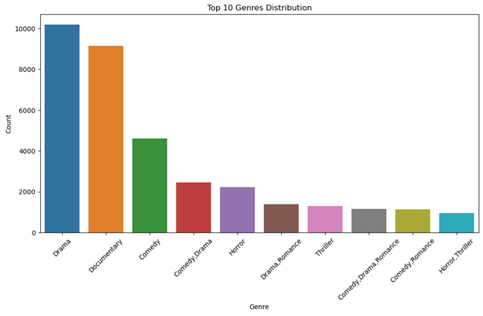
Top 10 Genre Distribution

Slide 9
Insights
As seen on the graph, we can note that drama had the most count of production over the years followed by Documentary then Comedy.
Let’s narrow down to some genre specific insights and analyze the top 5 genres based on runtime in minutes, average rating and number of votes for each genre and get an understanding of their correlations.

Slide 10
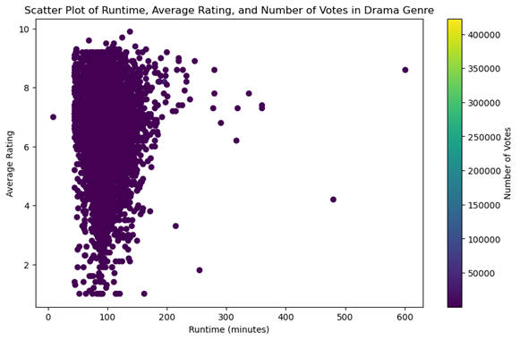
1. Drama

Slide 11
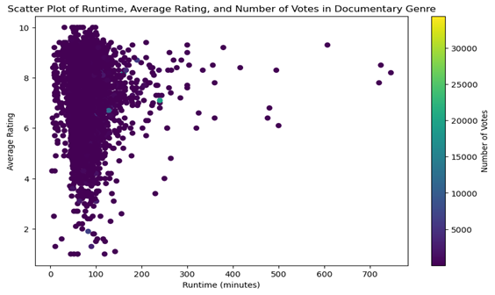
2. Documentary

Slide 12
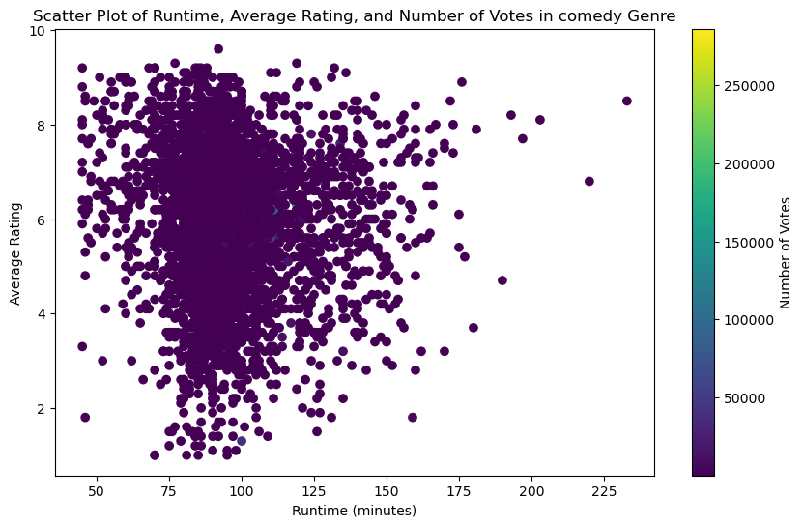
3. Comedy

Slide 13
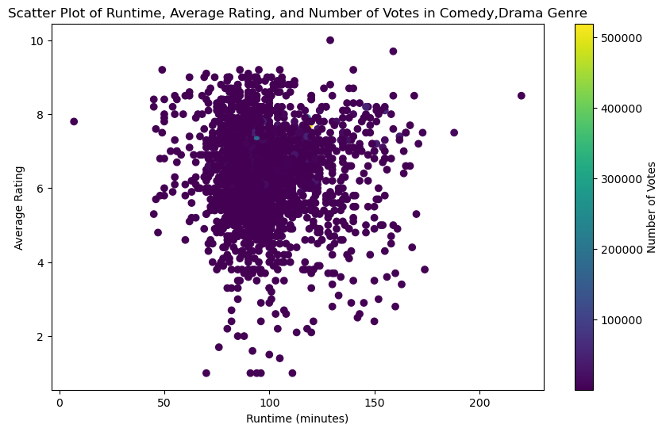
4. Comedy, Drama

Slide 14
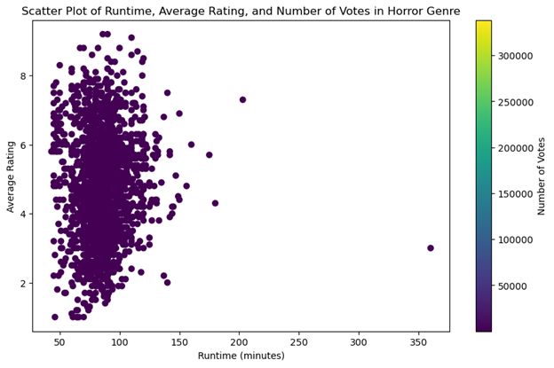
5. Horror

Slide 15
Findings
Our Scatter plot shows a concentrated cluster of data points. Which might suggest a strong correlation between our variables.
On the x-axis (Runtime in minutes) the data point is concentrated between 75 and 110 minutes which suggests that runtime is an import factor of consideration when making movies and according to this data the average runtime should be between 75 and 110 minutes.
We can also deduce that the average ratings is directly proportional to the number of votes especially when we concentrate on the middle average ratings of the top 5 genres as shown on the scatter plots.

Slide 16
Let’s investigate these findings further by getting a sense of the trends of these genres over the last decade.
We will narrow down our analysis to finding out:
Whether there's a certain genre which has been gaining popularity over the past decade, even though our initial stage of analysis showed us that Drama was at the top.
Whether Drama has been consistent or not along with other genres over the past decade.
Which one holds more weight: average ratings or the number of votes?

Slide 17
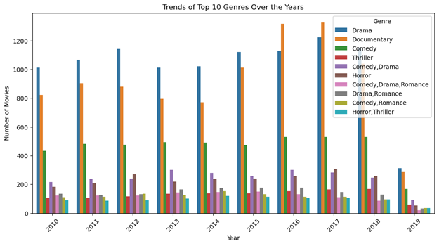
Trends of top 10 genres over the past decade based on the number of counts of the genres

Slide 18
Findings
As shown above;
From 2010 to 2019, Drama was the most preferred genre. However, Documentary's popularity surged from 2014 to 2017, outperforming Drama in 2016 and 2017. Comedy had a consistent performance.
The low count of movies in 2019 is explained by North American box office decline due to the Age of Online Streaming strengthening its foothold and the number of major Hollywood studios decreasing from six to five following the Disney-Fox merger.

Slide 19
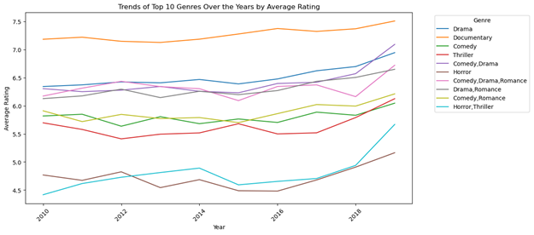
Finally, let’s try and see if the same reflects if we base our data on the average ratings, number of votes and the runtime over the past decade

Slide 20
Trends of Top 10 Genres over the years by Average Ratings
As shown on the previous slide:
Documentary was consistent as the genre with the highest average ratings (7.2 to 7.5), followed by Drama, Comedy/Drama, and Drama/Romance.

Slide 21
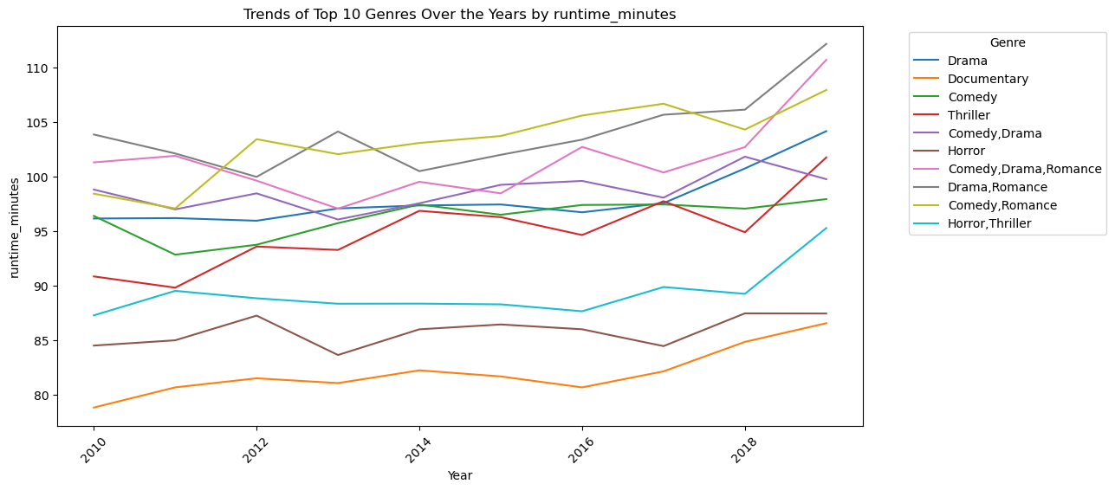
Trends of Top 10 Genres over the years by runtime (minutes)

Slide 22
Trends of Top 10 Genres over the years by runtime (minutes)
As shown on the previous slide:
The concentration of runtime between 75 and 110 minutes suggests its importance in movie production. This has been consistent over the last decade.

Slide 23
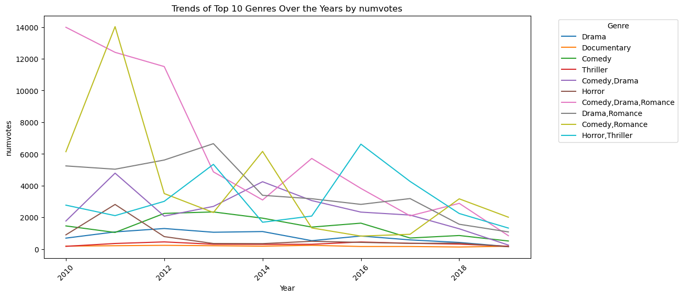
Trends of Top Genres over the years by Number of votes

Slide 24
Trends of Top Genres over the years by Number of votes
As shown on the previous slide:
Drama and Documentary didn't perform well in terms of the number of votes besides being the genres with the highest number of production, while the Comedy/Drama/Romance combo received more votes besides being among the genres with the number of counts in terms of production.

Slide 25
Conclusions
Drama is the best-selling genre, closely followed by Documentary and Comedy.
Successful genres have runtimes of between 75 and 110 minutes.
Ratings have a stronger impact on sales than the number of votes. Streaming services have affected theater ticket sales.

Slide 26
Limitations:
Analysis does not explain audience genre preferences.
Limited datasets restricted deeper exploration of profitability, release dates, and other factors

Slide 27
Way Forward
Incorporate additional datasets for deeper insights.
Formulate analyses that uncover reasons behind audience preferences.

Slide 28
Recommendations:
Prioritize Drama and Documentaries for production.
Maintain a 75 to 110-minute runtime.
Focus on average ratings over vote counts.
Invest in online streaming services for broader audience reach

Slide 29
Thank You
Thank you for your attention. For further inquiries, please contact ahmed.haji@student.moringaschool.com

